Slide 1
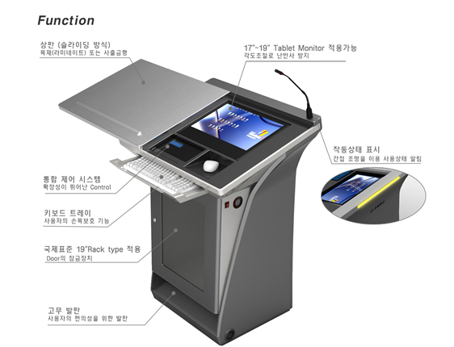
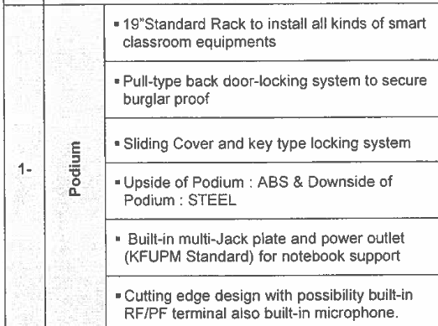
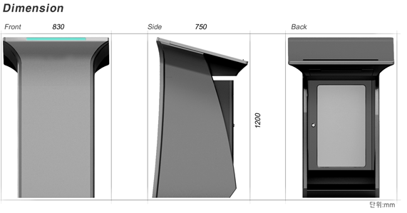
1. E – Podium : General
①
③
②
④
⑥
③
④
⑤
⑤
④
①
⑥
( E-Podium basic Structure )
1. Mechanical : Steel Body, ABS Plastic Sliding Cover,
Door (Locking Type)
2. Display: 19” Touch monitor, 10.4” Sub Monitor (New)
3. Electronic: Controller, Goose neck MIC, AMP, Speaker
Cable Accessory etc
②

Slide 2
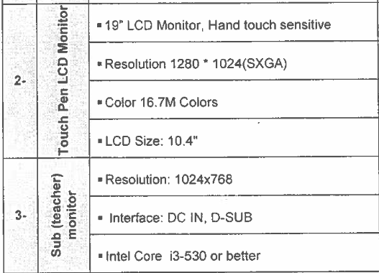
2. E – Podium : Display
Touch Monitor
1) Size: 19”
2) Resolution: 1280 x 1024 (SXGA)
3) Color: 16.7M
4) Brightness: 300 cd/㎡
5) Interface: D-Sub, USB
6) Power: DC12V
6) Touch Solution
- Type: Resistive 5-wire touch screen
- Touch Input Method: Stylus pen or Finger
- Touch Interface: USB, RS232, PS/2
2. Sub Monitor
1) Size: 10.4”
2) Resolution: 1024 x 768
3) Interface: D-Sub
4) Power: DC 12V
※ Current Model:
Does not apply for sub monitor however it can be
apply and it need design change.

Slide 3
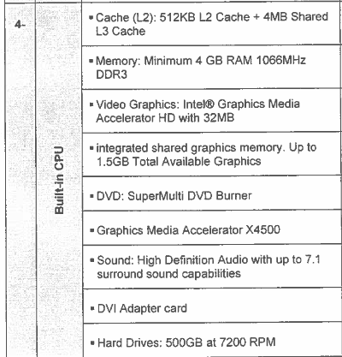
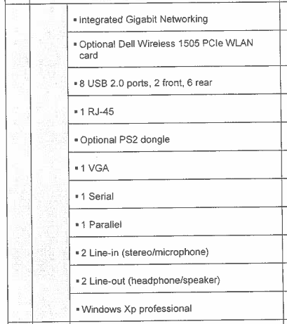
3. E – Podium : PC

Slide 4
Current Specifications for PC
Mother B/D | CPU | Intel 1155b Socket, i3 Processor Intel 32nm CPU Support Intel Turbo Boost Technology 2.0 Support
 | Chipset | Intel H61
 | Memory | 2 x DMM, Max 16GB, Dual Channel Support DDR3 1333/1066 Memory
 | Graphic | Built-in Graphic Processor Multi VGA Output Support: DVI/RGB port - DVI Max Resolution: 1920 x 1200 @60Hz - RGB Max Resolution: 2048 x 1536 @75Hz Max Shared memory: 1748MB
 | Extend Slot | 1 x PCle 2.0 x 16
 | Memory Equip. | Intel H61 Chipset: 4 x SATA 3Gb/s port
 | LAN | Realtek 8111E, Pcle Gigabite LAN Controller
 | Audio | VIA VT1708S, 8-Channel High Quality CODEC - Jack Detection, Multi-streaming, Front Panel Jack retasking support
 | USB | 8 x USB 2.0 port (Internal 4 / Rear 4)
CPU | Manufacturer | Intel, Core i3-2120
 | Socket Type | LGA1155
 | Operating speed | 3.3GHz
 | Core Type | Dual Core (4T/2C)
 | Cache | L1 Cache 2 x 32KB / 2 x 32KB L2 Cache 2 x 256KB L3 Cache 3M Shared
 | Internal Memory Controller | Dual Channel DDR3-1333, Max 32GB
 | Graphic Core | Intel Graphic HD2000 (EU 6pcs)
 | Core Click | 850MHz
 | Graphic card Support | Single x 16, Dual x8 / x8
 | OS | Win7 32/64 bit

Slide 5
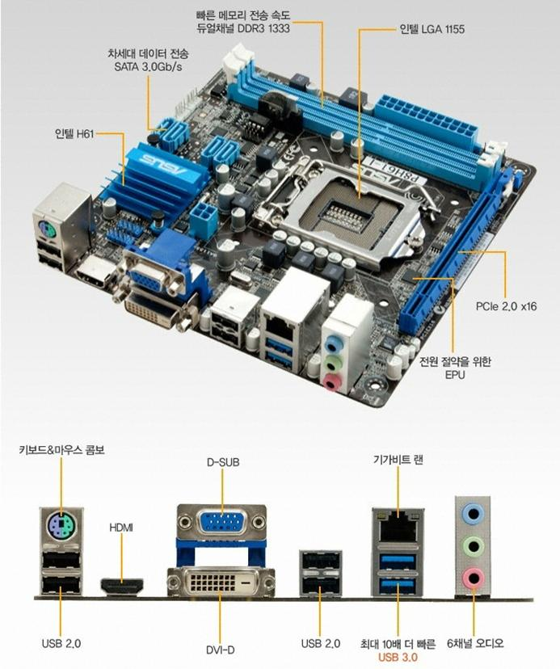
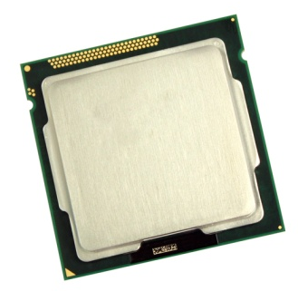
Mother Board
CPU

Slide 6
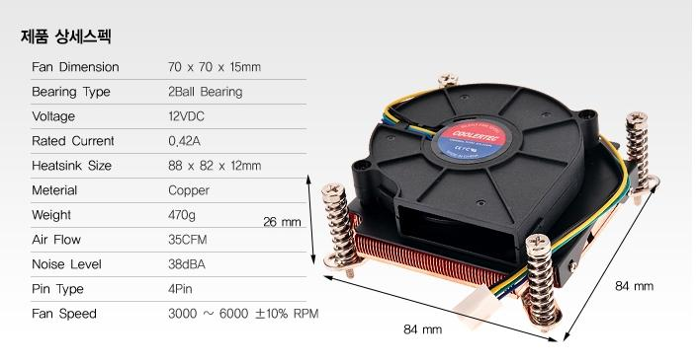
Cooler

Slide 7
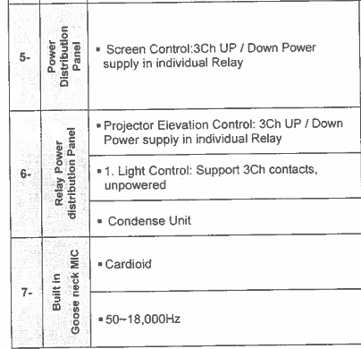
4. E – Podium : Controller

Slide 8
Current Specifications for Controller
◆ User interface
Touch screen | Touch type LCD screen control
Key-pad | Capacitive touch type key pad
USB 2.0 for PC | USB 2.0 full speed for PC
RFID | Save and Load Data on RFID TAG
◆ Inputs
RGB INPUTS | 2 Ports / HD15F 250MHz
RGB Signal Type | UXGA, RGBHV, RGBS, RGsB
Horizontal Fre. | 15 KHz to 110 KHz
Vertical Fre. | 30 Hz to 170 Hz
Composite Video Input | 1 RCA composite & 1 Stereo Audio
Stereo Audio Inputs | 2 / 3.5mm stereo, 1 RCA stereo
microphone inputs | 1 Dynamic Mic, 1 Goose-neck Mic, 1 Bluetooth Mic(wireless)
RF Tuner | NTSC M/N, Full frequency range from channel 2 (55.25MHz) to channel 135 (859.25MHz)
Power | DC 14V 4A, AC220V
◆ Outputs
RGB OUTPUTS | 2 Ports / HD15F 250MHz / UXGA, RGBHV, RGBS, RGsB
Composite Video Output NTSC Decoder | 1 RCA / video & RF Tuner Output NTSC to RGB Decoder
Audio Power Amp | Stereo 2Ch (30W+30W)
Mic Amp Audio Aux Output | 1 Dynamic Mic, 1 Goose-neck Mic, 1 Bluetooth Mic(wireless) 1 / 3.5mm Stereo Connector
Screen & Elevation Control Lock Control | 2 AC 220V Outputs 2 Solenoid Lock Control Outputs
RS-232 Control | 2 / 3.5mm Stereo Connector PC & projector Connected

